Slide 1
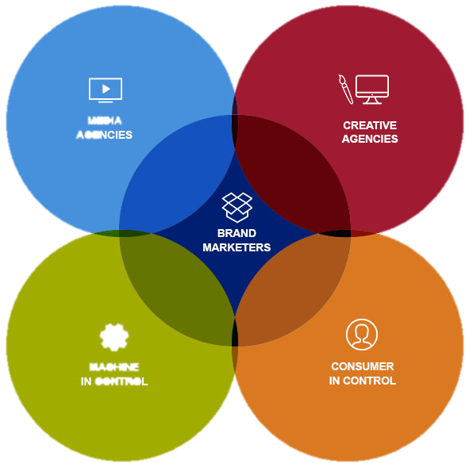


THE
VIRTUOUS
CIRCLE
JULIN SHAW
SENIOR MANAGER, INTERACTIVE

Slide 2
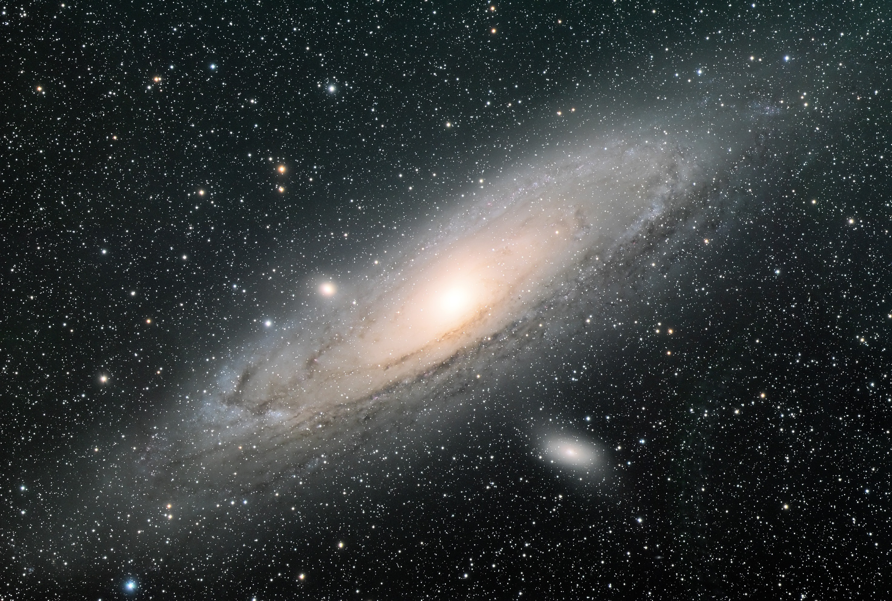

In August 2014…
Michigan iLottery was launched…

Slide 3






UNPRECEDENTED SALES
$147
$120
$107
$56
iLOTTERY SALES
$54

Slide 4





Slide 5
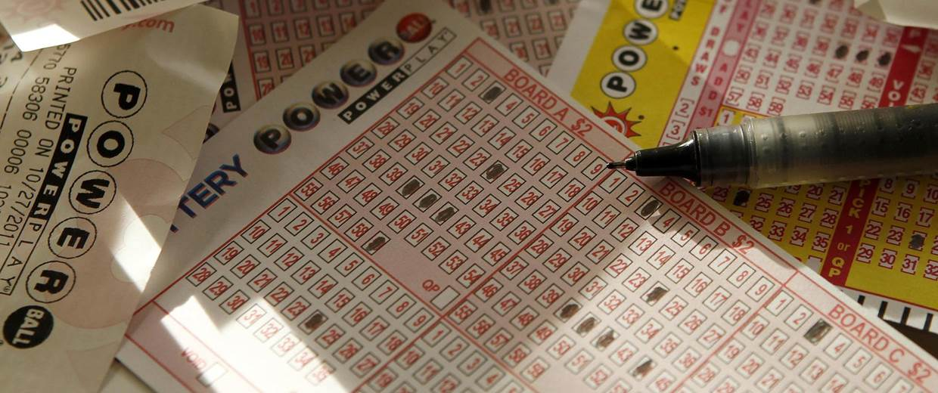

Slide 6
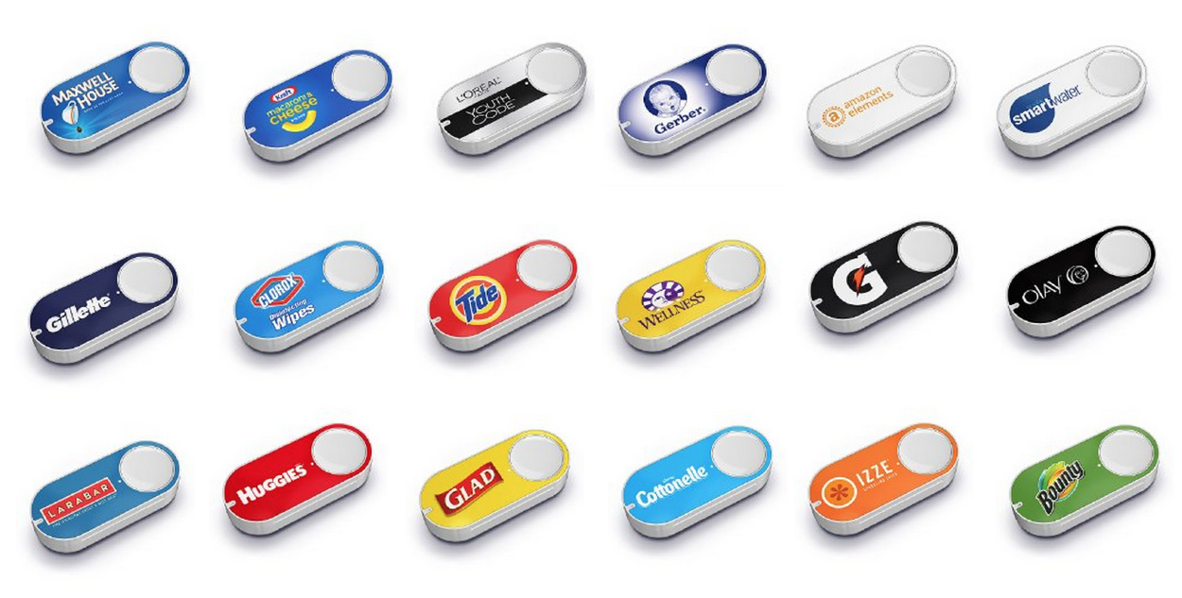
BUILDING THE EXPERIENCE
in a one-click world

Slide 7

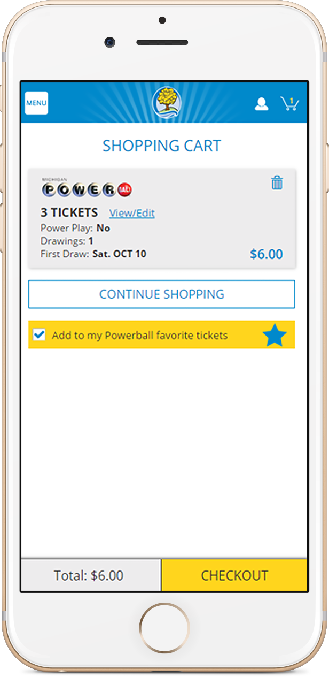
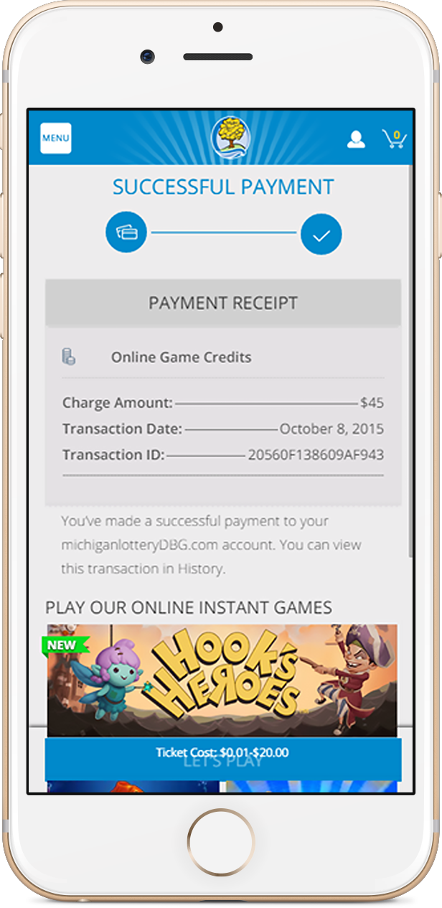
1
2
3
purchase flow

Slide 8

engage new players

Slide 9


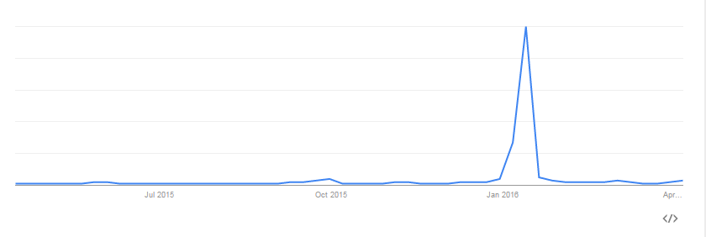
powerball
powerball
powerball
100

Slide 10

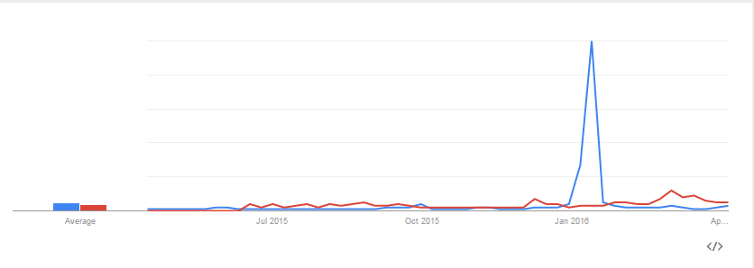
donald trump

Slide 11

50%
INCREASE IN
PAGEVIEWS

Slide 12


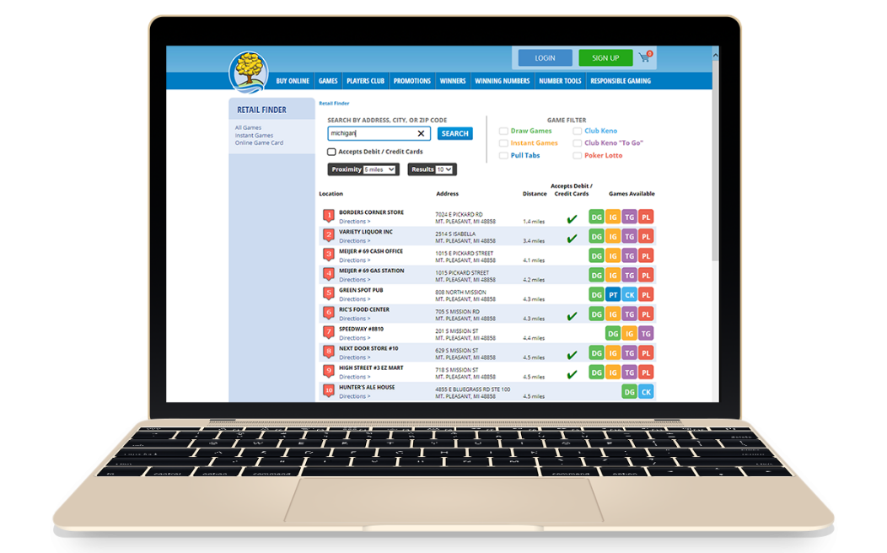

RETAIL

Slide 13



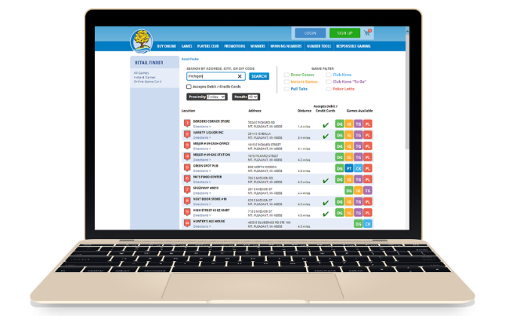
THE
VIRTUOUS
CIRCLE
IN ACTION
RETAIL
RETAIL

Slide 14


Slide 15
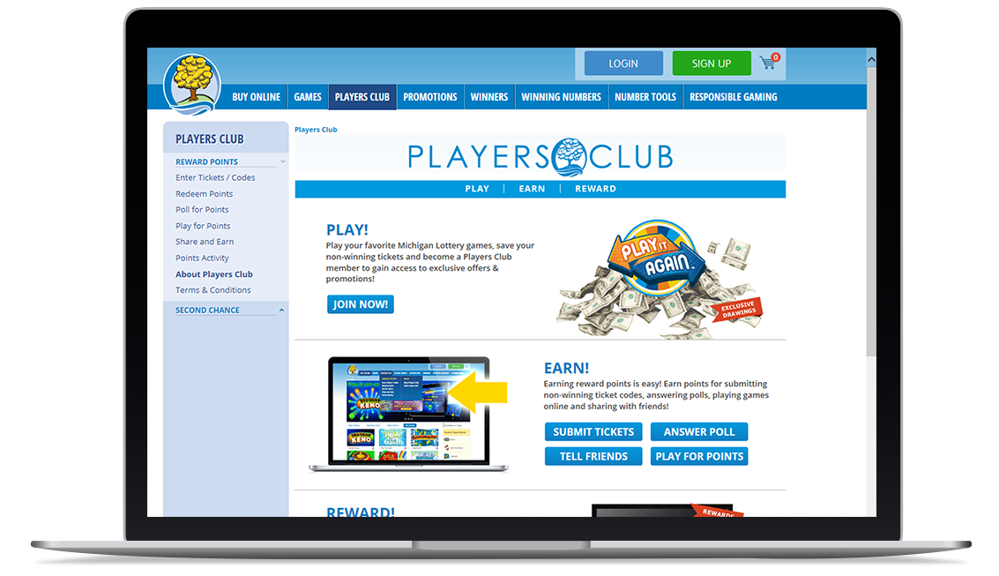
PLAY FOR POINTS

Slide 16


Slide 17
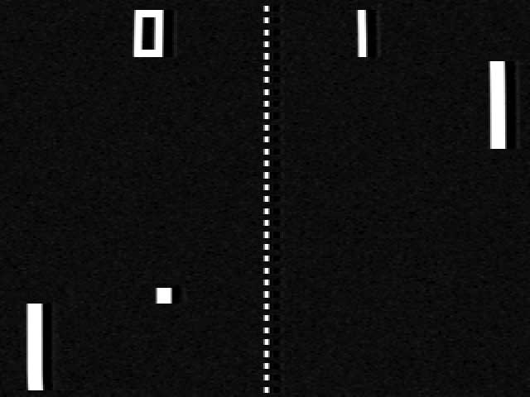
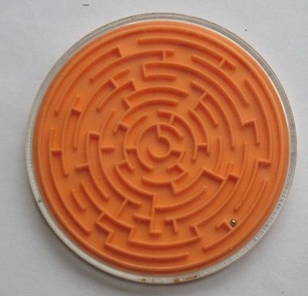

Slide 18
iLottery Solutions. Powerful Results.
jshaw@pbl.ca

